Slide 1
Level 6 Group 5
Jay Pointer, Dalton Kirk and Ashley Burton

Slide 2
Objectives
Log Line- A social competitive snack game with tactical immersion.
Demographic - 18-24 Males & Females, Mobile Users
Males tend to enjoy competition
Females tend to enjoy Nurturing
Players Goal- Compete against your friends, by seeing who can unlock the most zones.
Unlock cool loot as you go!

Slide 3
Player Experience and Fun
Player Experience
Easy Fun - Curiosity in future mechanics and zones
Stress – Failing to complete levels
Hard Fun + Fiero – Defeating Bosses, Navigating Zones
People Fun – Competing against your friends, Sharing Unlocks
Serious Fun – Collections (sails and pets)
4 Types of fun by Nicole Lazzaro

Slide 4
Progression System
Players progress through the game by navigating zones and defeating bosses
Zones will get tougher and require upgraded boat parts
Defeating a boss rewards the player with materials
Materials are used for upgrading the boat

Slide 5
Mechanics – Navigating Zones

Slide 6
Mechanics - Boss Fight

Slide 7
Cosmetics - Sails

Slide 8
Cosmetics - Pets

Slide 9
Social Competition
Facebook integration
See what zones your friends have completed
Post what you have unlocked (zones, cosmetics)

Slide 10
Rewards
Rewards will encourage players to keep playing our game
Rewards will make players feel better about playing our game
Getting rewards creates investment

Slide 11
How We Will Reward – New Sails
Fixed time reward – new random sail every 7th day you play the game
Cosmetic item that allows customisation
Creates daily habit of launching game (Hook model, Nir Eyal)
Peacock effect – Look at me now

Slide 12
How We Will Reward - Chests
A chest will be awarded to a player for defeating a boss.
Chests contain variable rewards specific to that zone.
Possible rewards from chests include: Unique sails, materials or unique pets

Slide 13
Immersion
Tactical Immersion
Skill required to complete the zone will keep players immersed
Could be phrased as “In the Zone”

Slide 14
Mobile Accessibility
UI
Size of everything on the screen
Art Style
Input
Short Levels

Slide 15
Issues we faced
Mechanics were not fun
Changed to the top down navigation
Enjoyed exploring
More control
Game lifetime and scalability
Boss fights
Upgrades
Infinitely scale
Limited Options in the Future
Different hazards and handmade zones

Slide 16
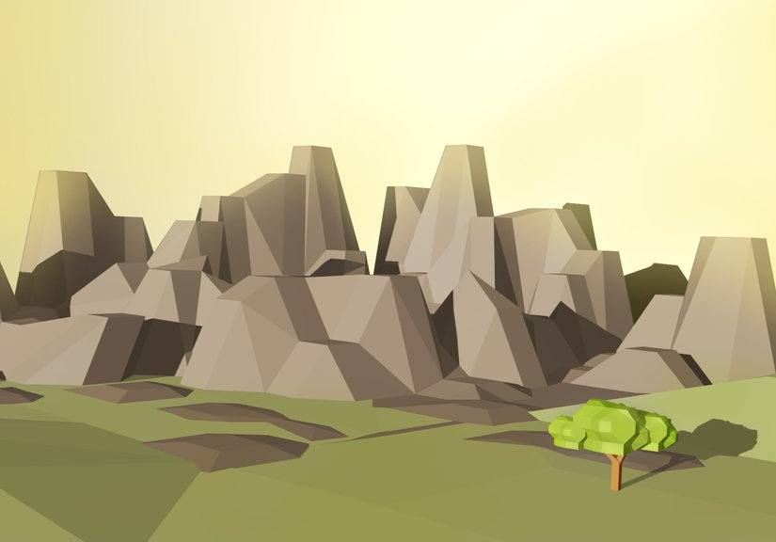

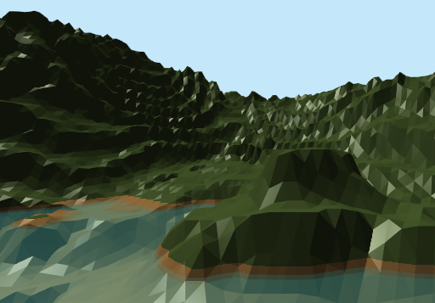
Art Style
Low poly 3d Art Style
Pastel Colours

Slide 17
Questions?

